Slide 1

Graph Theory Project
Problem C

Slide 2
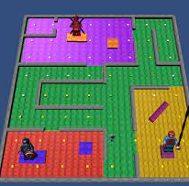
Dijkstra’s Algorithm:
1.In Game development:
In game development, Dijkstra's algorithm is frequently used for pathfinding, a crucial aspect of enabling non-player characters (NPCs) to navigate through game environments efficiently. Pathfinding algorithms help NPCs determine the optimal route from one point to another, considering factors like terrain, obstacles, and other dynamic elements within the game world.
Graph Representation: The game environment is represented as a graph, where nodes represent discrete locations (e.g., grid cells or waypoints), and edges have weights reflecting the cost or distance between nodes.
Node Navigation: NPCs need to move from one node to another within the game world. Dijkstra's algorithm assists in determining the most efficient path by considering the weights associated with edges.
Dynamic Environments: Game environments often change dynamically, with moving obstacles or evolving conditions. Dijkstra's algorithm can be adapted to accommodate these changes and recalibrate paths in real-time.
Implementation with Heaps: To enhance efficiency, implementations of Dijkstra's algorithm often use priority queues or heaps to prioritize nodes with the shortest tentative distances during traversal.
Reference: One classic reference for Dijkstra's algorithm and its application in game development is the book "Artificial Intelligence: A Modern Approach" by Stuart Russell and Peter Norvig. This widely used textbook provides comprehensive coverage of AI concepts, including pathfinding algorithms.

Slide 3

2.In Electronics and Circuit Design:
In electronics and circuit design, Dijkstra's algorithm plays a crucial role in the process of routing connections on a printed circuit board (PCB). PCB routing involves determining the optimal paths for electrical connections between different components, such as integrated circuits, resistors, and other electronic elements.
Graph Representation: The layout of a PCB can be represented as a graph, where each component is a node, and the connections between them are edges. The edges have weights representing the cost or distance associated with routing traces between components.
Connection Optimization: Dijkstra's algorithm is employed to find the shortest and most efficient paths for connecting various components on the PCB. The algorithm considers factors like the number of layers in the PCB, the cost of vias (inter-layer connections), and any design constraints imposed by the circuit.
Reference: One notable reference for understanding the application of Dijkstra's algorithm in circuit board routing is the book "High-Speed Digital Design: A Handbook of Black Magic" by Howard Johnson and Martin Graham.

Slide 4
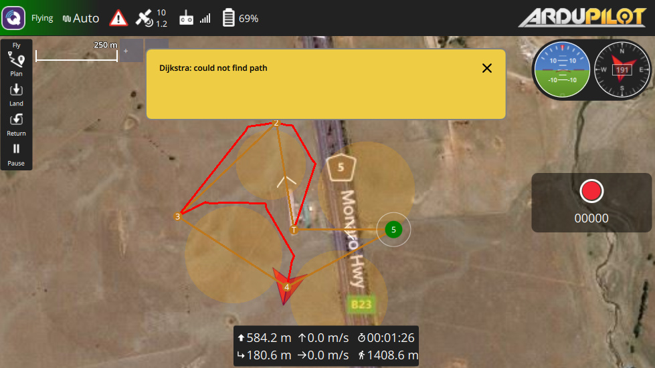
3.In Flight Path Planning:
In the aviation industry, Dijkstra's algorithm is a key tool used for optimizing flight paths. Flight path planning involves determining the most efficient route for an aircraft, taking into account various factors such as air traffic, weather conditions, and fuel efficiency. Dijkstra's algorithm aids airlines in minimizing travel time, reducing costs, and enhancing overall operational efficiency.
Graph Representation: The airspace is modeled as a graph, with airports and waypoints serving as nodes. Connections between these nodes represent air routes, and the edges are weighted based on factors such as distance, air traffic, and other relevant considerations.
Optimizing Travel Time: Dijkstra's algorithm is employed to find the shortest path between the departure and destination airports, considering the weights associated with each route. This optimization helps minimize the overall travel time for the flight.
Reference: One reference that provides insights into flight path planning and the use of algorithms in aviation is the book "Introduction to Airborne Radar" by George W. Stimson. While primarily focusing on radar technology, this book discusses aspects of aircraft navigation, including flight path planning and optimization.

Slide 5
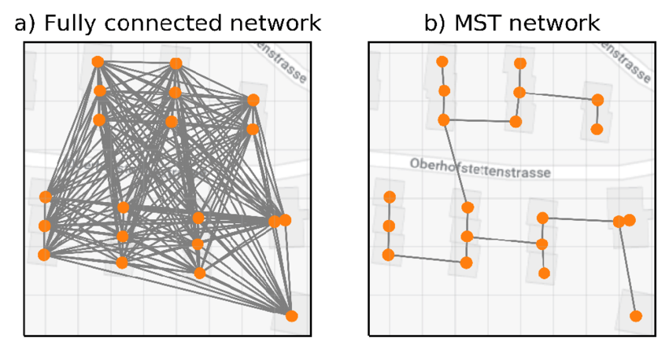
Kruskal’s Algorithm:
1.In Network Design:
Network design involves the establishment of connections between different locations while minimizing the overall cost of infrastructure. Kruskal's algorithm is a widely used approach for finding the minimum spanning tree (MST) in a connected, undirected graph. In the context of network design, the graph represents the locations to be connected, and the edges are associated with the cost of establishing connections.
Graph Representation: Nodes: Represent different locations, such as cities or network node. Edges: Represent potential connections between locations, with weights indicating the cost of establishing those connections.
Reference: One reference that provides a comprehensive understanding of algorithms, including Kruskal's algorithm and its applications in network design, is the book "Algorithms" by Robert Sedgewick and Kevin Wayne.

Slide 6
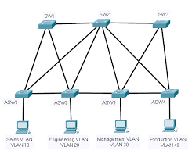
2.In Traffic Management:
Traffic management in urban planning involves optimizing the flow of vehicles through intersections and road networks to minimize congestion and reduce waiting times. Kruskal's algorithm, typically used for finding minimum spanning trees, can be adapted to optimize traffic signal connections in a city.
Graph Representation: Nodes: Represent intersections or traffic signal locations. Edges: Represent potential connections between intersections, with weights indicating the cost of signal synchronization or the waiting time for vehicles.
Reference: While specific references on the adaptation of Kruskal's algorithm for traffic signal optimization may be limited, a related resource that delves into traffic engineering principles is the book "Traffic Flow Theory: Characteristics, Experimental Methods, and Numerical Techniques" by Daiheng Ni.

Slide 7
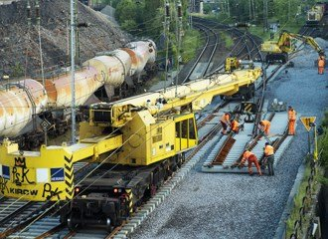
3.In Railway Construction:
Railway track construction involves connecting different cities or industrial centers with an efficient layout of tracks while minimizing construction and maintenance costs. Kruskal's algorithm, designed for finding minimum spanning trees, can be applied to determine the optimal layout of railway tracks.
Graph Representation: Nodes: Represent locations such as cities or industrial centers that need to be connected. Edges: Represent potential railway connections between locations, with weights indicating the cost of construction and maintenance.
Reference: While specific references on the application of Kruskal's algorithm in railway track construction may be limited, a related resource that provides insights into railway engineering principles is the book "Railway Engineering" by Satish Chandra and M. M. Agarwal.

Slide 8
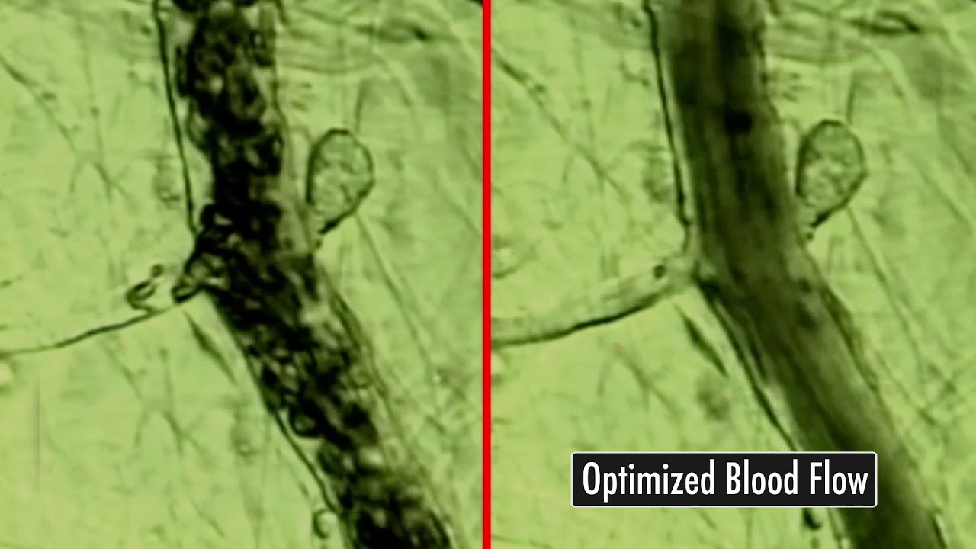
Augmenting Flow Algorithm:
1.Blood Flow Optimization:
The circulatory system in biological organisms, including humans, plays a crucial role in transporting blood to various parts of the body. The optimization of blood flow within this intricate network of vessels is essential for maintaining overall health. Augmenting flow algorithms can be applied to model and optimize blood flow, considering factors such as vessel capacities, minimizing pressure imbalances, and ensuring efficient nutrient and oxygen delivery.
Reference: While specific references on the application of augmenting flow algorithms in blood flow optimization may be limited, a broader reference in the field of computational biology and physiology is the book "Computational Physiology" by Thomas Bearden and Richard Johnston.

Slide 9
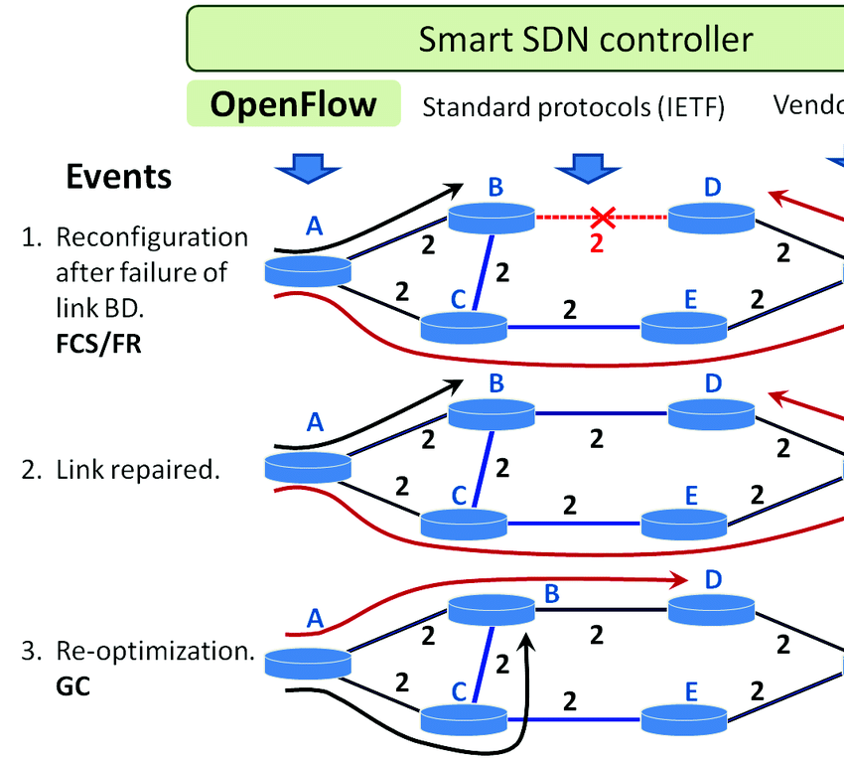
2.Internet Traffic Routing Optimization:
The efficient routing of internet traffic is crucial for ensuring reliable and high-performance communication across the complex network infrastructure. Augmenting flow algorithms, specifically designed for optimizing flow within networks, can be applied to enhance the routing of internet traffic. This optimization involves selecting the most efficient paths for data transmission, considering factors such as available bandwidth, minimizing congestion, and ensuring timely delivery.
Reference: A comprehensive reference in the field of computer networks that covers internet traffic routing and optimization, including augmenting flow algorithms, is the book "Computer Networking: Principles, Protocols, and Practice" by Olivier Bonaventure.

Slide 10
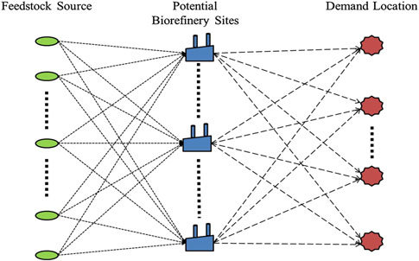
3.In Supply Chain Optimization:
Supply chain management involves the efficient flow of resources, such as raw materials and components, from suppliers to manufacturers, distributors, and retailers. Augmenting flow algorithms can be applied to optimize the flow of resources through the supply chain, ensuring maximum efficiency, minimizing delays, and improving overall supply chain performance.
Reference: While specific references on augmenting flow algorithms in the context of supply chain management may be limited, a foundational reference in the field of supply chain optimization is the book "Supply Chain Management: Strategy, Planning, and Operation" by Sunil Chopra and Peter Meindl.

